Slide 1


CS 6831 Designing Secure Cryptography
Tom Ristenpart

Slide 2
Randomized encryption
Symmetric encryption scheme is tuple
(randomized) key generation
(randomized) encryption
(deterministic) decryption
Assume length of ciphertext determined solely by length of message: clen(|M|)

Slide 3
Real-or-random indistinguishability
Can’t distinguish from random bits under chosen-message attack
Adversary can repeatedly query Enc on same message

Slide 4
Counter-mode for block cipher
IV + 1
IV + 2
IV + 3
IV is random 128 bit value
E_{K}
E_{K}
E_{K}
P1
P2
P3
M1
M2
M3
C1
C2
C3

Slide 5

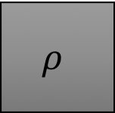
Database encryption
M
M
E_{K}
$$ρ$$
$$≈$$
C
C
PRF security

Slide 7
Data encryption standard (DES)
L0 R0
(Omitting initial and final permutations)
Originally called Lucifer
team at IBM
input from NSA
standardized by NIST in 1976
F_{K1}
+
Key schedule expands 56-bit key into 16 48-bit round keys
n = 64
k = 56
Number of keys:
72,057,594,037,927,936
L1 R1
F_{K2}
Split 64-bit input into L0,R0 of 32 bits each
Repeat Feistel round 16 times
+
Each round applies function F using
separate round key
L2 R2
…
…

Slide 8
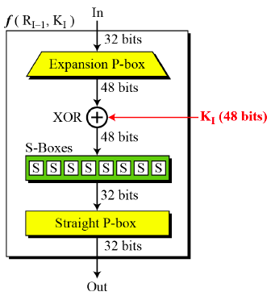
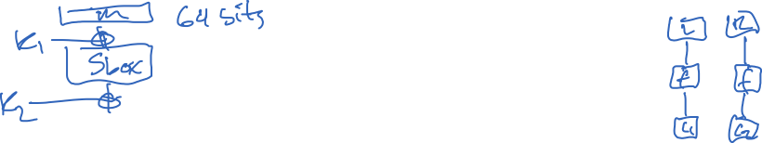
DES round functions
P-box expands 32 bits to 48 bits and permutes
8 S-Boxes:
Each a 6-bit to 4-bit lookup table
XOR in round key
16 48-bit round keys derived via key schedule from 56 bit key deterministically
How S-boxes chosen? Why particular permutations?

Slide 9

Linear cryptanalysis
[Matsui 1993]
Approximate E_{K} by linear boolean function satisfied w/ probability different from ½ (over choice of random message)
For string X and set S $⊆$ {0,…,n-1}, let X[S] =
M
E_{K}
Suppose we know S_{m} , S_{c} , S_{k} such that
C
where C = E_{K}(M) and M chosen uniformly
Then this allows recovering 1 bit of K using known plaintext attack

Slide 10


Linear cryptanalysis: recovering one bit
(1)
Let M₁ , … , M_{q} be uniform messages, C_{i} = E_{K}(M_{i})
M
Let K[S_{k}] = Maj( { M_{i}[S_{m}] $⨁$ C_{i}[S_{c}] }_{i} )
E_{K}
C
Chernoff bound!

Slide 12
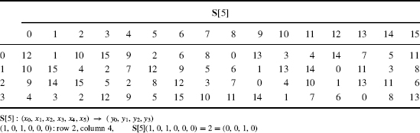
Finding linear approximations
Need to determine a good linear approximation of cipher
For DES, only non-linearity is due to S-boxes
Can we find linear approximation of S-Box?

Slide 13
Finding linear approximations
Can we find linear approximation of an SBox?
Number of possible S_{x} , S_{y} ?
64 x 16
Directly compute bias of each possible S_{x} , S_{y}
# of X for which
Subtract 32 to get bias

Slide 14
S_{y}
X[1] X[2] X[3] X[4] X[5] X[6]
Sbox₅
Y[1] Y[2] Y[3] Y[4]
S_{x}
12 / 64 times!

Slide 15




Finding linear approximations
Can we find linear approximation of S-Box?
Number of possible S₀ , S₁ ?
64 x 16
Directly compute bias of each possible S₀ , S₁
# of X for which
minus 32
Use Sbox approximation within full round function to get one-round linear approx:

Slide 16
Finding linear approximations
Combine linear approximations for different rounds together, to get function of known values and key bits
L0 R0
F_{K1}
Additive combination of different linear approximations
“Piling up” heuristic: calculate bias across multiple rounds by heuristically treating round estimators as independent
+
L1 R1
F_{K2}
+
L2 R2
…
…

Slide 17

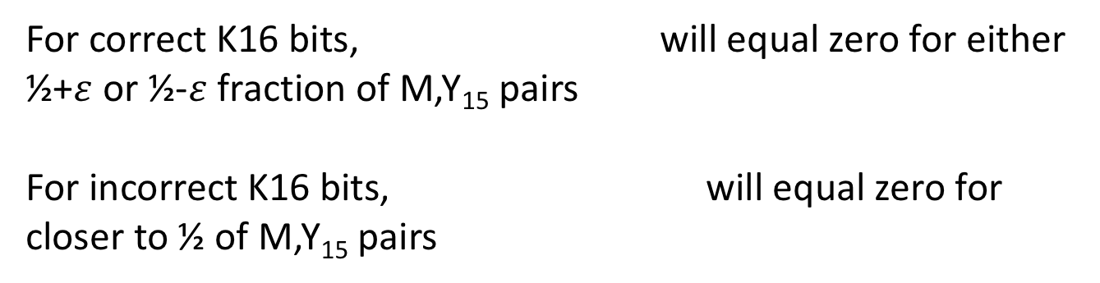





Recovering many key bits
L0 R0
F_{K1}
Use a linear approximation of 15 rounds. Let Y₁₅ = L15 || R15
+
L1 R1
Partially decrypt last round – subset of K16 key bits used
…
…
For correct K16 bits, will equal zero for either ½+$ε$ or ½-$ε$ fraction of M,Y₁₅ pairs
For incorrect K16 bits, will equal zero for closer to ½ of M,Y₁₅ pairs
L15 R15
F_{K16}
+
Gives maximum-likelihood estimator of subset of K16 bits
Similar approach for 1st round, w/ estimator of last r-1 rounds
Combine this approach with brute-force of remaining key bits
L16 R16
…
…

Slide 18
Recovering many key bits
L0 R0
F_{K1}
Breaks 8-round DES with:
2²¹ known plaintext/ciphertext pairs
40 seconds of 1992 computation time (66 Mhz!)
+
L1 R1
…
…
L15 R15
Breaks 16-round DES with:
2⁴³ known plaintext/ciphertext pairs
~2⁴¹ DES computations in expectation
F_{K16}
+
L16 R16
…
…

Slide 19
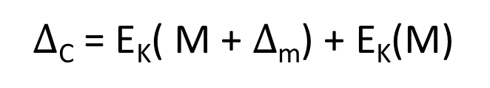
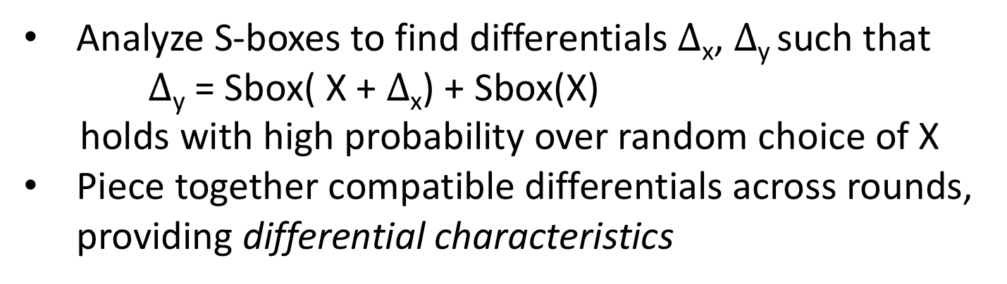
Differential cryptanalysis
[Biham, Shamir 1990]
Look for weaknesses based on pairs of inputs
$∆$_{C} = E_{K}( M + $∆$_{m}) + E_{K}(M)
M
Find $∆$_{m} s.t. $∆$_{C} holds with high probability (over choice of M)
E_{K}
Analyze S-boxes to find differentials $∆$_{x}, $∆$_{y} such that $∆$_{y} = Sbox( X + $∆$_{x}) + Sbox(X)
holds with high probability over random choice of X
Piece together compatible differentials across rounds, providing differential characteristics
C
Leads to chosen plaintext attack

Slide 20
Best attacks against DES
Attack | Attack type | Complexity | Year
Biham, Shamir | Chosen plaintexts, recovers key (differential cryptanalysis) | 2⁴⁷ plaintext, ciphertext pairs | 1992
Matsui | Known plaintexts, recovers key (linear cryptanalysis) | 2⁴³ plaintext, ciphertext pairs | 1993
DESCHALL | Brute-force attack | 2^{56/4} DES computations 41 days | 1997
EFF Deepcrack | Brute-force attack | ~4.5 days | 1998
Deepcrack + DESCHALL | Brute-force attack | 22 hours | 1999

Slide 21

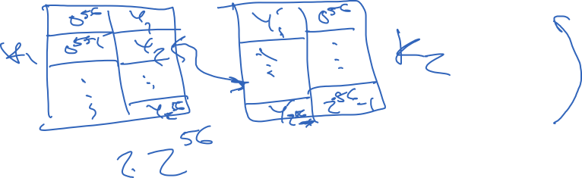

2DES and 3DES
Increase key length by composing cipher with separate keys
M
Security not as high as one would expect, due to meet-in-the-middle attack
E_{K1}
Y
E_{K2}
C

Slide 22
2DES and 3DES
M
Increase key length by composing cipher with separate keys
E_{K1}
Security not as high as one would expect, due to meet-in-the-middle attack
Y
E_{K2}
Triple-DES provides 112-bits of security
Z
E_{K1}
C

Slide 23
AES competition
4-year NIST competition to pick new cipher (1997-2000)
15 submissions
5 finalists
Rijndael selected as winner
Joan Daemen
Vincent Rijmen

Slide 24
Advanced Encryption Standard (AES)
A form of key-alternating cipher
M
n = 128
k = 128, 192, 256
+
K1
Number of keys for k=128:
340,282,366,920,938,463,463,374,607,431,768,211,456
SubBytes
ShiftRows+MixCols
Substitution-permutation design.
For k=128 uses 10 rounds of:
+
K2
1) SubBytes (non-linear 8-bit S-boxes)
2) ShiftRows & MixCols (linear permutation)
3) XOR’ing in a round key
SubBytes
ShiftRows+MixCols
(Last round skips MixCols)
+
K3
…

Slide 25
Abstract block cipher designs
L0 R0
M
F_{K1}
Feistel
F is a function
+
K1
P
+
L1 R1
Key-alternating
ciphers
- P is a permutation
- “Iterated Even-Mansour”
+
K2
F_{K2}
P
+
L2 R2
+
K3
…
…
…

Slide 26
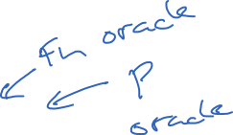
Key-alternating ciphers: theory
Can analyze in a model where P is modeled as a random permutation
M
+
K1
First example of an idealized model
Add P oracle to PRF1 and PRF0 games
P
+
K2

Slide 27
Advanced Encryption Standard (AES)
M
Designed to resist linear & differential cryptanalysis
“Wide-trail” strategy
Ensure large # of Sboxes involved in any multi-round trail
Use coding theory viewpoint to build permutations to ensure rapid diffusion
+
K1
SubBytes
ShiftRows+MixCols
+
K2
SubBytes
ShiftRows+MixCols
+
K3
…

Slide 28
Best attacks against AES
Brute-force attack (try all keys): expected time ~2¹²⁷
Attack | Attack type | Complexity | Year
Bogdanov, Khovratovich, Rechberger | Key recovery | 2^{126.1} time + 2⁸⁸ data | 2011
Tao, Wu | Key recovery | 2^{126.01} time + 2⁷² data | 2015
No algorithmic attacks of practical relevance known

Slide 29
Side-channel attacks
M
Sbox’s are look-up tables
Fastest AES implementations do complete round via table look-ups of form T[M+K]
What table rows get accessed leaks information about key bits
Timing (cache hits)
Micro-architectural side channels
K1
+
SubBytes
ShiftRows+MixCols
+
K2
SubBytes
ShiftRows+MixCols
+
K3
…

Slide 30
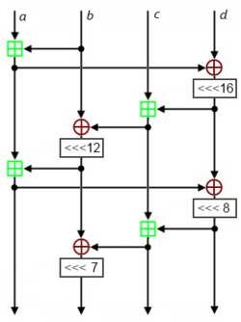
ARX ciphers
Additions, Rotations, XORs
Combination of operations leads to non-linearity
Easier to implement w/o side-channels
Examples:
Salsa20 / ChaCha ciphers
Speck, Simon (from NSA)
…
ChaCha20 quarter-round function

Slide 31
Moving forward
Assume good blockciphers that achieve PRF security up to implications of best-known generic attacks
~ 2^{k} time (exhaustive key search)
~ 2^{n/2} time (birthday attacks)

Slide 33
How to analyze block cipher security?
Cryptanalysis is area of study dedicated to determining if block cipher designs resist attacks
Mostly focus on discovering exploitable weaknesses in cipher that can speed-up key recovery
Known or chosen message attacks
Related-key attacks

Slide 34
How to analyze block cipher security?
Cryptanalysis is area of study dedicated to determining if block cipher designs resist attacks
Mostly focus on discovering exploitable weaknesses in cipher that can speed-up key recovery
Known or chosen message attacks
Related-key attacks

Slide 35
Linear cryptanalysis
Linear cryptanalysis:
Approximate S-box behavior by linear functions, e.g.,:
X1 + X2 + X6 = Y1 + Y2 + Y4
S-boxes exhibit some biases, meaning some linear functions are satisfied with higher probability (over uniform inputs)
Can carefully “pile up” linear approximations across multiple DES rounds
Use linear approximations to efficiently narrow down search for key, given lots of encryptions of uniform messages
[Matsui 1993]
http://www.cs.bc.edu/~straubin/crypto2017/heys.pdf

Slide 37
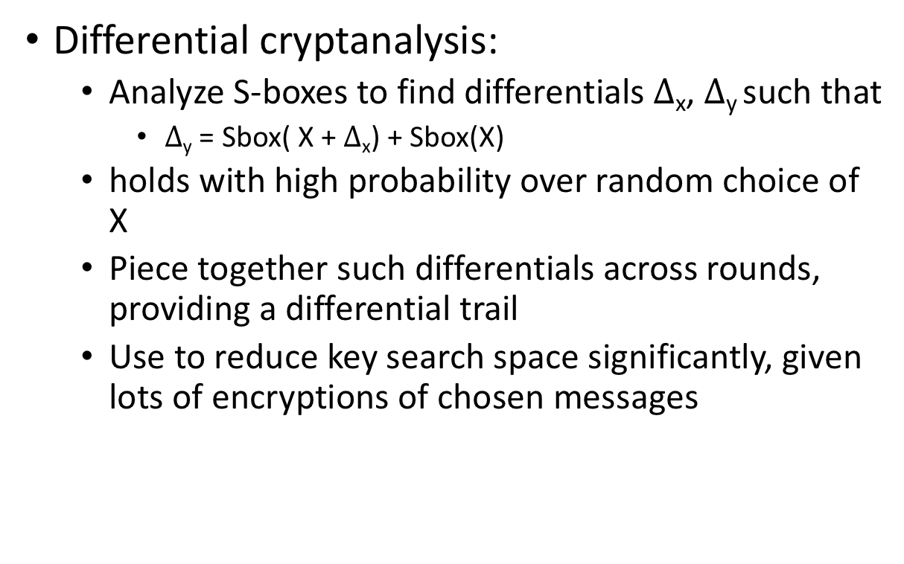
Differential cryptanalysis
Differential cryptanalysis:
Analyze S-boxes to find differentials $∆$_{x}, $∆$_{y} such that
$∆$_{y} = Sbox( X + $∆$_{x}) + Sbox(X)
holds with high probability over random choice of X
Piece together such differentials across rounds, providing a differential trail
Use to reduce key search space significantly, given lots of encryptions of chosen messages
[Biham, Shamir 1992]

Slide 38
Linear cryptanalysis
Idea: approximate cipher under a key by a linear function that holds with good probability over choice of random messages
In more detail:

Slide 39
Things to cover
Build up theory of block cipher design:
Simple Evan-Mansour cipher
Why not random S-boxes?
Variance in bias is high!
Evan-Mansour result (don’t go through in detail, probably)
Proving resistance to linear / differential cryptanalysis?
Focusing on just linear biases fails to protect against other algebraic approximations of S-boxes
ARX ciphers (ands, rotations, xors)
How does cryptanalysis work against these?

Slide 43
Towards message privacy definitions
Notes:
Multiple queries, security fails trivially, so restrict to a single query for now. Can do in game or by limiting types of adversaries considered
For any single-query otIND adversaries, can show that Adv(A) = 0
Prove that

Slide 44
OTP otIND security

Slide 45
Shannon’s theorem

Slide 47
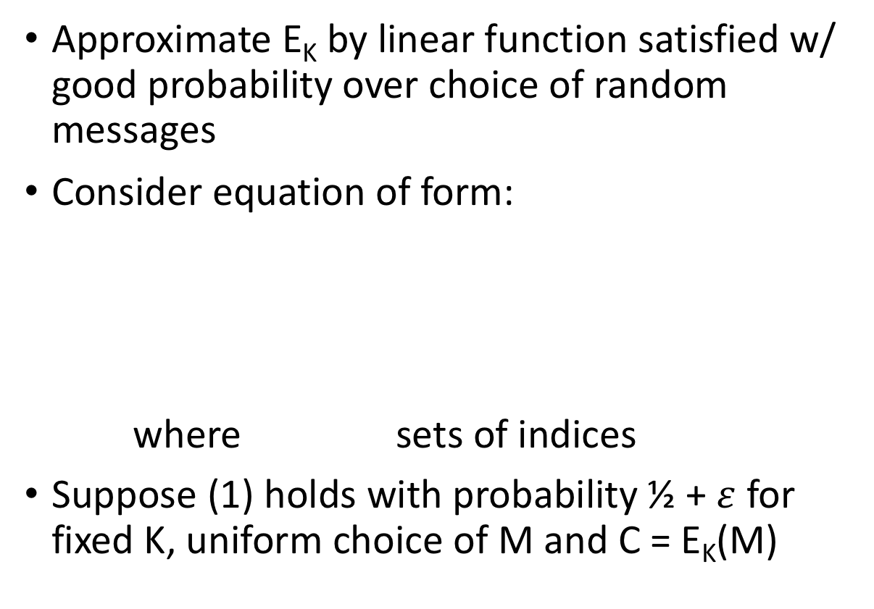
Linear cryptanalysis
[Matsui 1993]
Approximate E_{K} by linear function satisfied w/ good probability over choice of random messages
Consider equation of form:
where sets of indices
Suppose (1) holds with probability ½ + $ε$ for fixed K, uniform choice of M and C = E_{K}(M)
M₁ M₂ … M_{n}
E_{K}
(1)
C₁ C₂ … C_{n}
Example:

Slide 48
Recovering one bit of the key
Approximate E_{K} by linear function satisfied w/ good probability over choice of random messages
Consider equation of form:
where sets of indices
Suppose (1) holds with probability ½ + $ε$ for fixed K, uniform choice of M and C = E_{K}(M)
M₁ M₂ … M_{n}
E_{K}
(1)
C₁ C₂ … C_{n}
Example:

Slide 49
Finding linear approximations
Combine linear approximations for different rounds together, to get function of known values and key bits
L0 R0
F_{K1}
Additive combination of different linear approximations
“Piling up” heuristic: calculate bias across multiple rounds by treating round estimators as independent
+
L1 R1
F_{K2}
Recovers full 56-bit key using:
2⁴³ known plaintext/ciphertext pairs
~2⁴¹ DES computations in expectation
+
L2 R2
…
…

